Slide 1

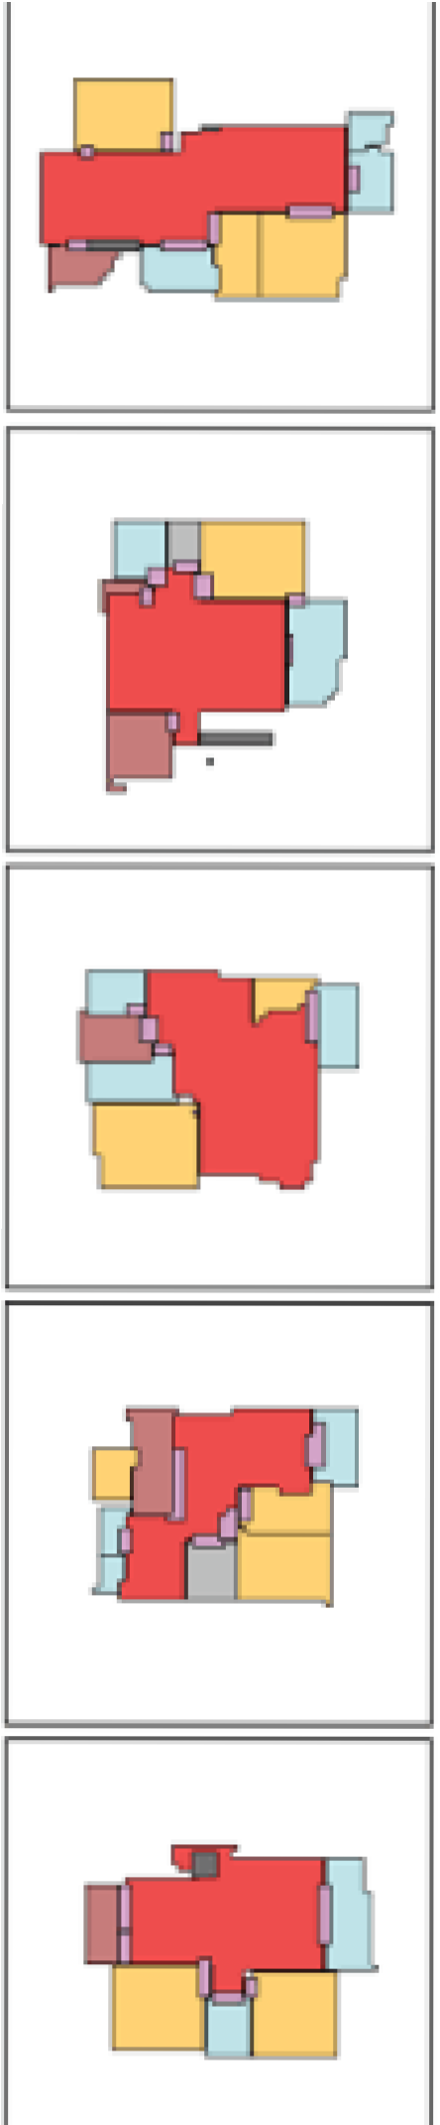
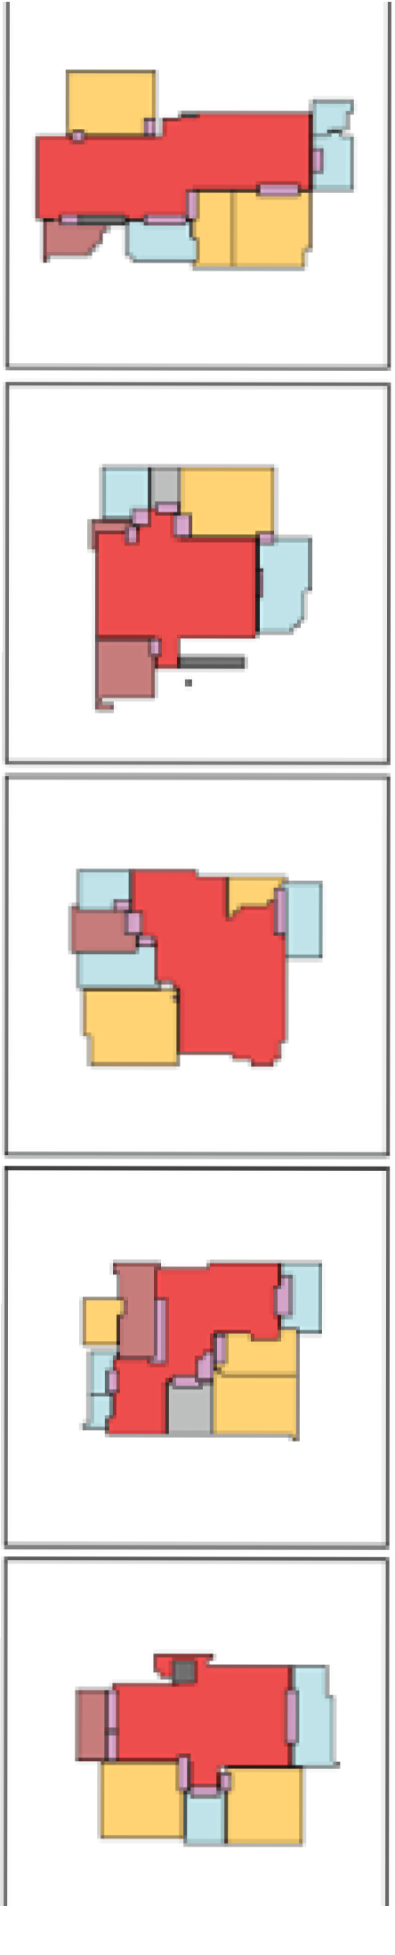

Capstone Phase A House-GAN++
Prof. Volkovich Zeev Dr. Avros Renata
Dorin Beery Mosa Hadish

Slide 2
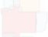
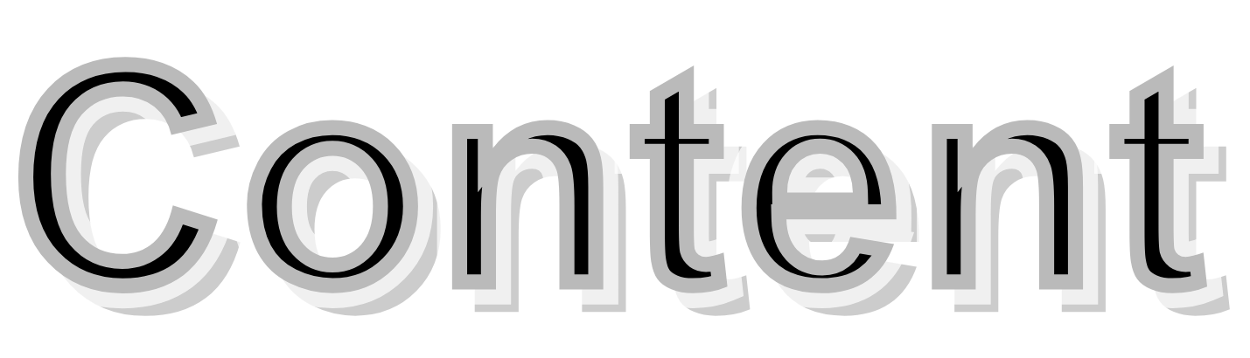


Introduction
System Overview Training
Meta Optimization
Evaluation Metrics Challenges
GUI
Diagrams References Thank You!

Slide 3




Project is related to the subjects of Machine Learning, Deep Learning, Adversarial Networks, and Meta-Optimization
The purpose is to generate floor plans automatically without the need for a professional architect
Aiming to reduce the cost of floor plan design.
Aiming to save time for architects and clients interested in
floor plans - Moving to a new house is tiring enough!

Slide 4


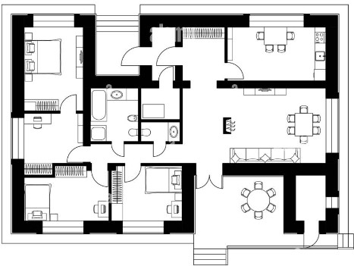
30K INS for regular architect, more than 80K INS for professional architect.
Stacks include private sector and also public sector.
Approaching to low, medium and high society population. Architects show interest in the model and hope for its application.

Slide 5


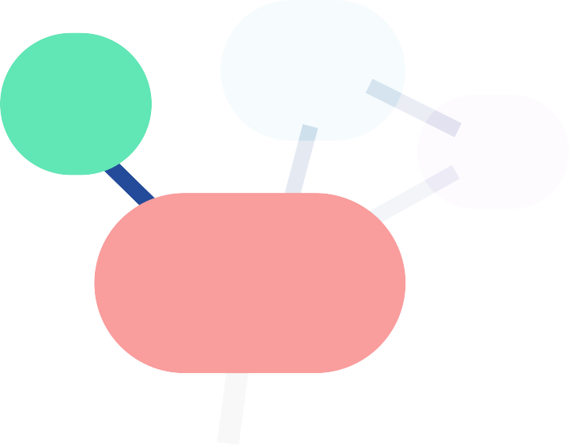





House-GAN++ is based on House-GAN, they differ in:
Edges also carry features
Each node/edge carries 2-D segmentation mask
Convolution Message Passing Network is reformulated
House-GAN++ includes meta-optimization refinement scheme
bubble diagram
->condition image
^{segmentation} feature volumes relational graph
segmentation masks graph
masks
1 1 0
1 1 0
1 1 0
0 0 0
bedroom
1
1
0
kitchen
0
0
0
bathroom
0 | 0 | 0
0 0 0 0 |  | 1
 |  | 1
0 0 0
0 0 1
0 0 1
Conv-MPN
living room
0 0 1
0 0 1
64x64x1
8x8x16 Segment
8x8x16
feature volume
8x8x32 feature volume

Slide 6

segmentation masks
feature volumes
relational graph
segmentation masks graph
bubble diagram
->condition image
1
1 1 0
1 1 0
0 0 0
1
0
bedroom
1
1
0
kitchen
0
0
0
bathroom
0 | 0 | 0
0 | 0 | 1
0 | 0 | 1
0 0 0
0 0 1
0 0 1
Conv-MPN
living room
0 0 1
0 0 1
64x64x1
8x8x16 segment
8x8x16
feature volume
8x8x32 feature volume

Slide 7



Each component is encoded with a 12-D one-hot vector and and a 128-D noise vector
0 | 1 | ... | 0 | 0
one-hot vector noise vector
linear reshape
kitchen
8x8x16
feature volume

Slide 8
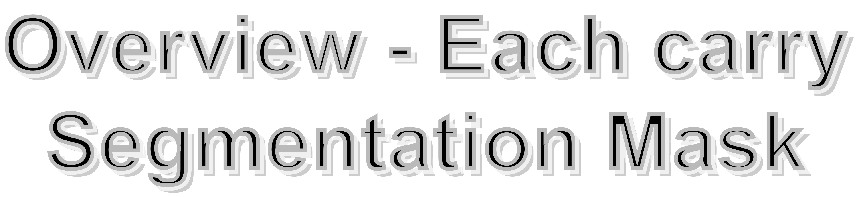
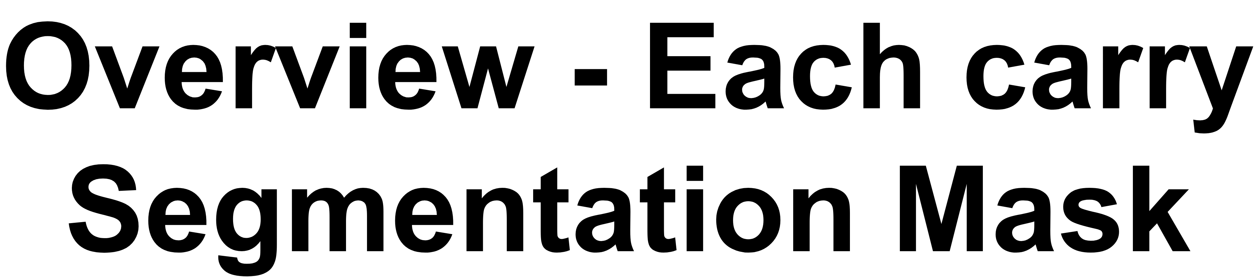
Each node/edge carries 2-D segmentation mask
1 1 0 0
1 1 0 0
1 1 0 0
0 0 0 0
1
0
1
x3 CNN
1 1
0
kitchen
0
0
0
Segmentation mask of room boundaries 64x64x2 and a flag indicating wether to use the segmentation or not
8x8x16

Slide 9


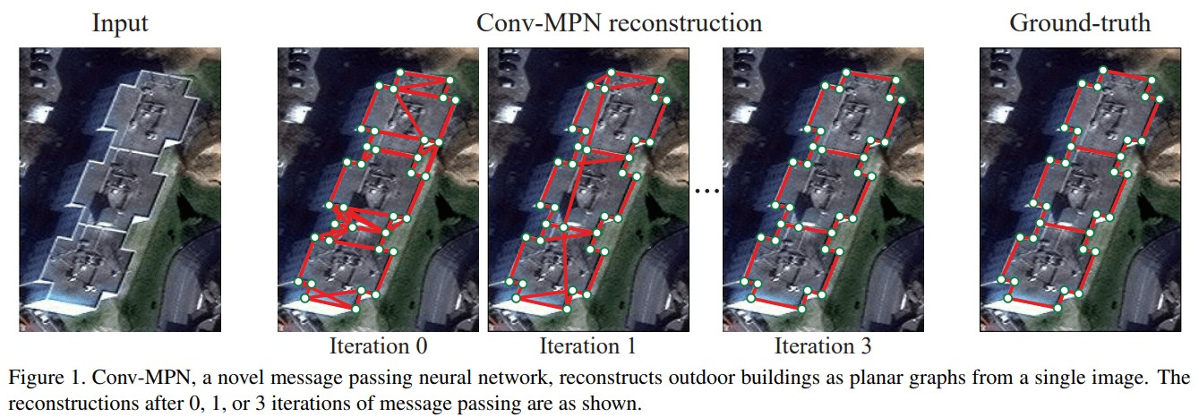
Find boundaries of rooms and enhance their layout. Message passing between nodes and edges with 3 layer CNN on the concatenation of
[room feature map, room k-1 neighbours, room non-neighbours]

Slide 10
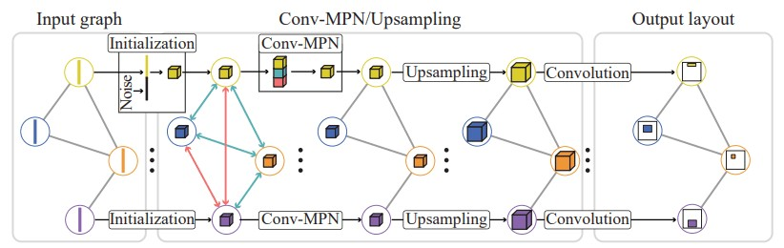
Flow chart of Conv-MPN is taken from House-GAN which means that a representation of edges (doors) as nodes are missing in the input graph.

Slide 11
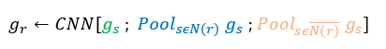
CNN applied on 3 components
segmentation masks graph
Conv-MPN
64x64x1
Also, a upsample x3 times outputs with graph of segmentation masks of size 64x64x1

Slide 12





















These were the main concepts regarding the proposed novelty.
All these steps are included in the Generative Adversarial Network (GAN).
GANs include a Generator and a Discriminator, they aim to play a game where the generator generates data based on data it learned,
discriminator decides if the data given to it is real or generated.

Slide 13

Generator
segmentation masks
feature volumes relational graph
segmentation masks graph
bubble diagram
->condition image
1
1 1 0
1 1 0
0 0 0
1
0
bedroom
1
1
0
kitchen
0
0
0
bathroom
0 | 0 | 0
0 | 0 | 1
0 | 0 | 1
0 0 0
0 0 1
0 0 1
Conv-MPN
living room
0 0 1
0 0 1
64x64x1
8x8x16 segment
8x8x16
feature volume
8x8x32 feature volume

Slide 14
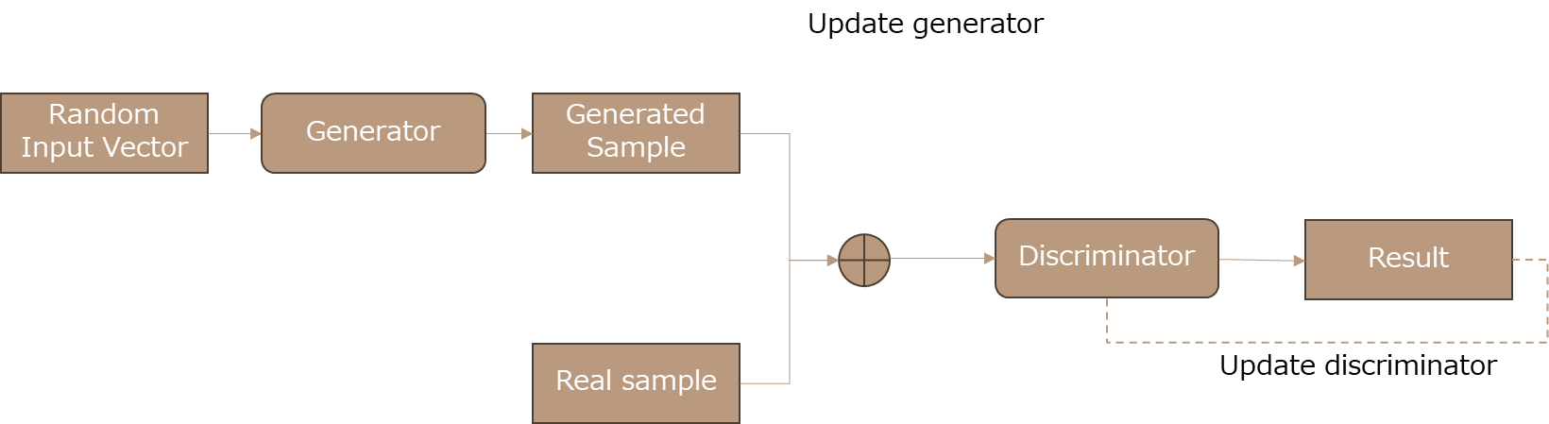

Slide 15




In each training step:
pick a random GT layout.
initialize a relational graph with the bubble diagram.
specify a GT segmentation mask as condition for each room/door.

Slide 16


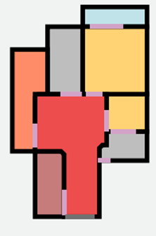
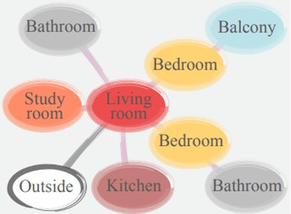

Pick ground truth
layout at random with correspoinding bubble diagram
Initialize relational graph
Specify segmentation mask for
each room/door
Pass
to the generator the graph, include
segmentation mask for a room/door at a 50% chance
[1] House-GAN++

Slide 17
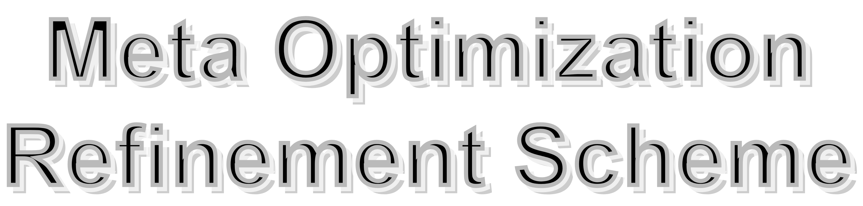
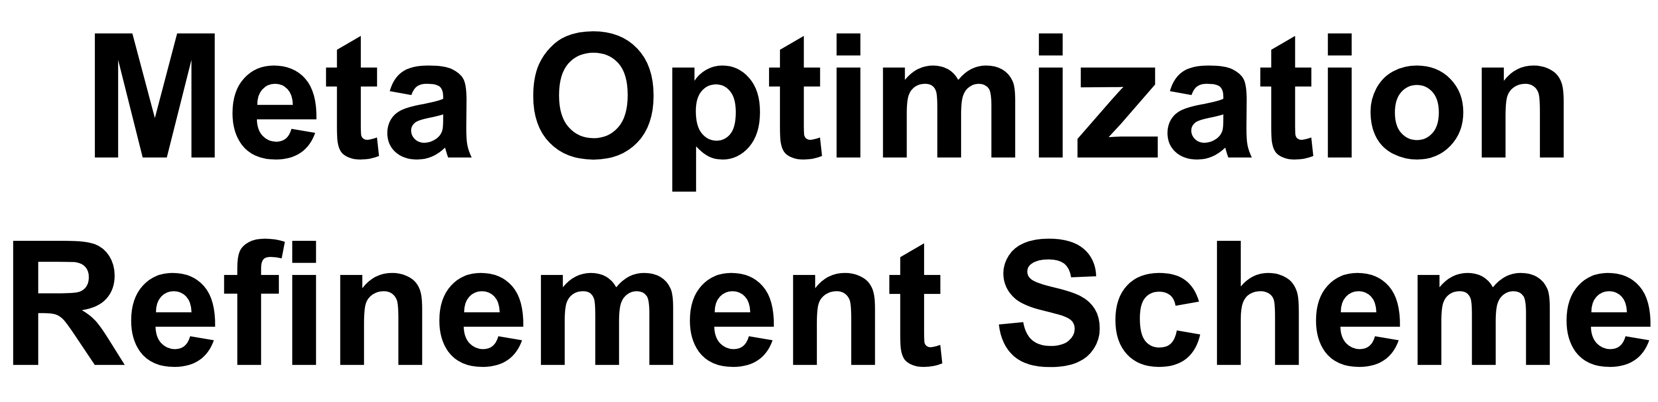
The model refines layouts iteratively, which is called refinement scheme.
The purpose of Meta Optimization is to optimize the refinement scheme.
Three strategies control when to pass which constraints:
Fixed Heuristics
Static Scheme
Dynamic Scheme

Slide 18
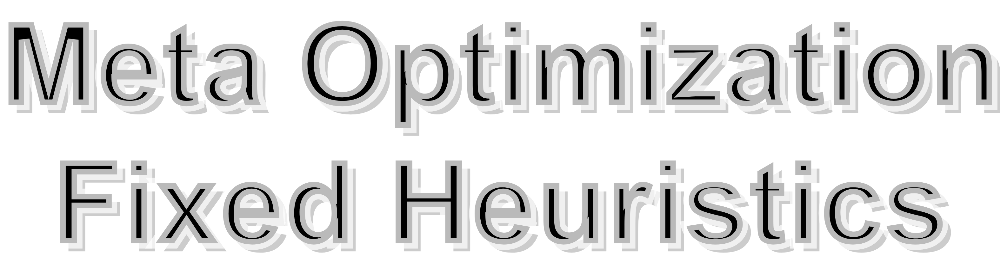
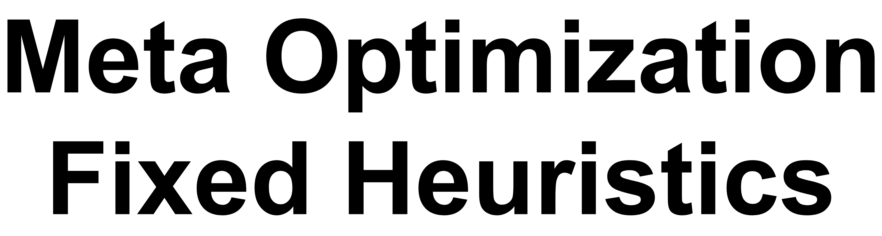
Pass the segmentation mask for each room/door at a 50% chance at every
iteration (Ours 50% heur).
The second is to always specify all the conditions (Ours100% heur).

Slide 19
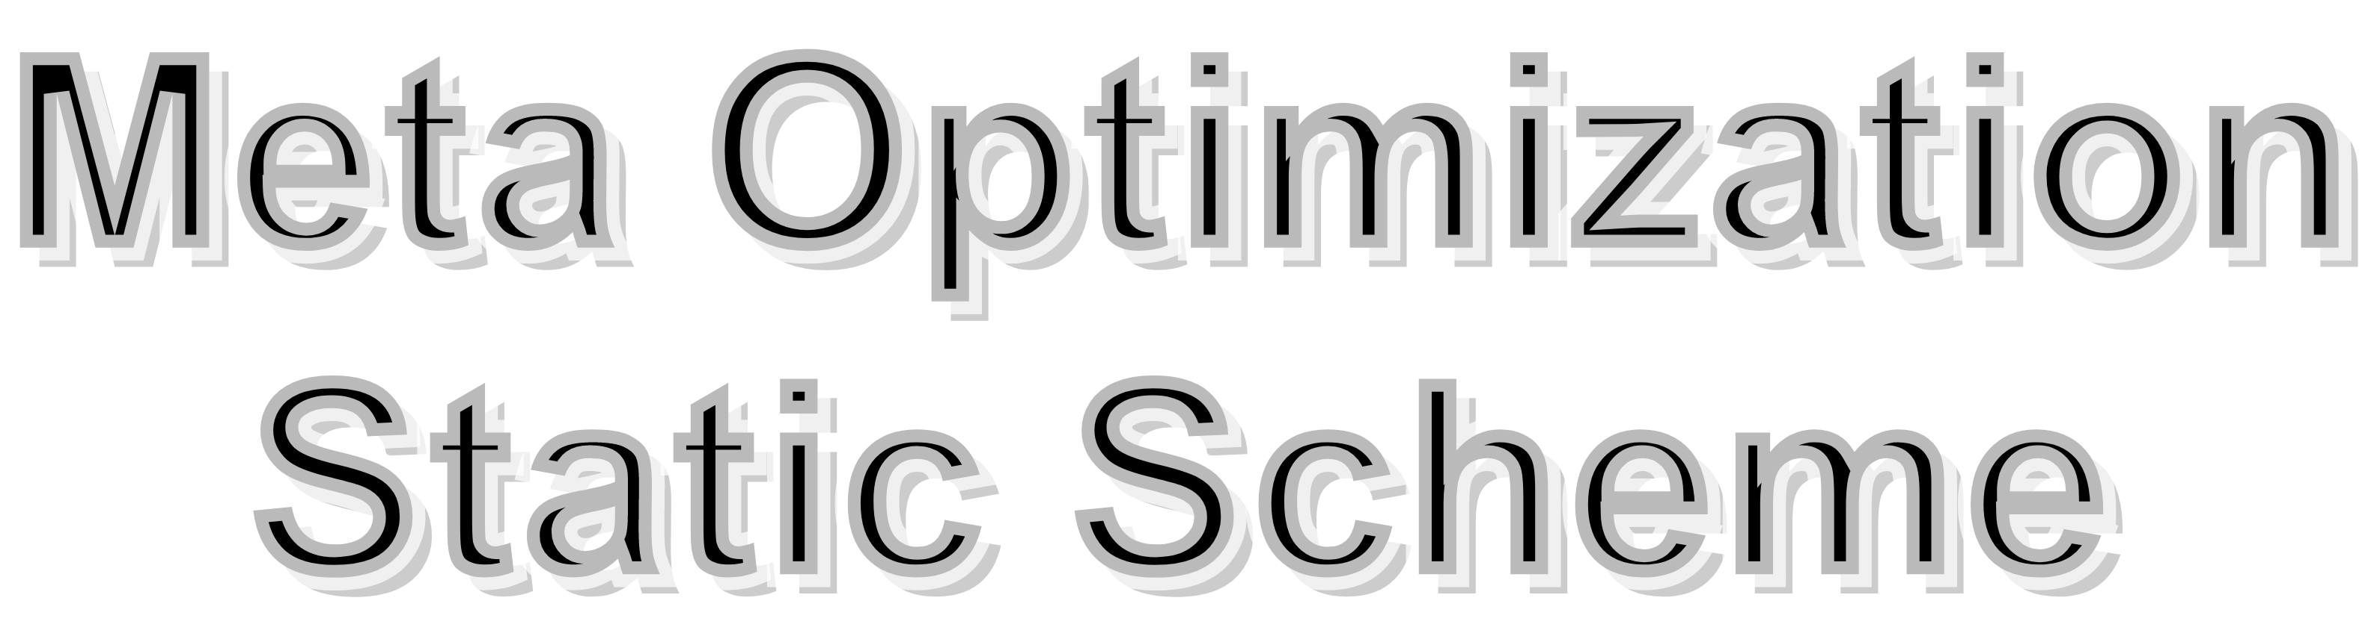
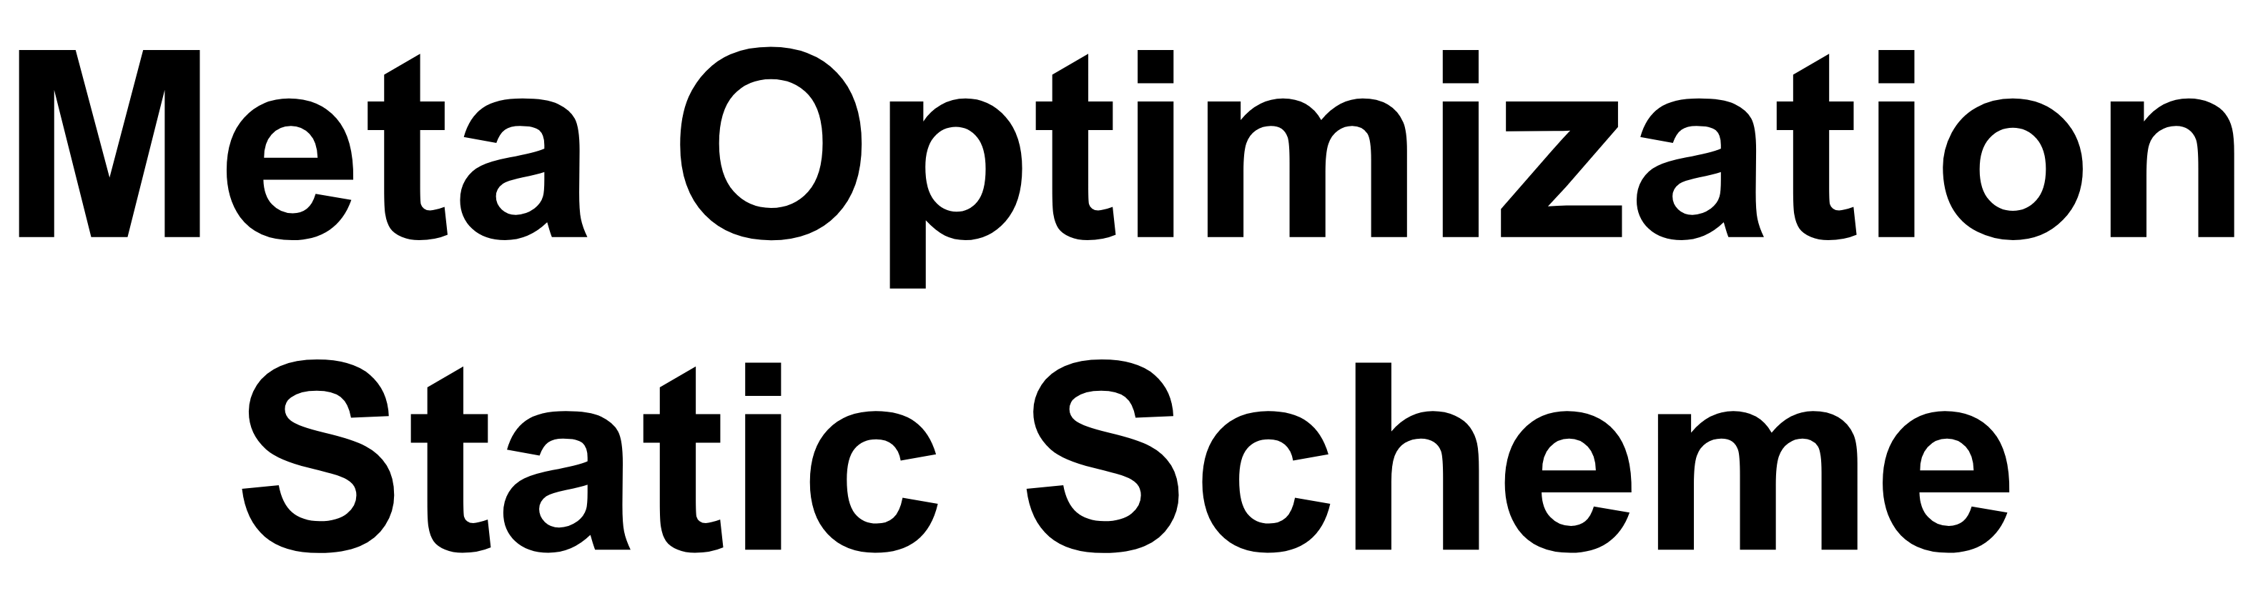
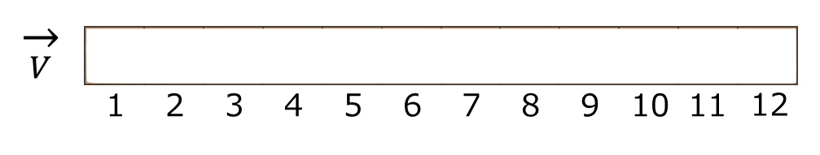
Based on the observation that architects design certain spaces first.
Use a 10-d vector {Vi}, where i represents room types and two door types Each element’s value ranges between [1,10]
Example vector v: The previous mask is specified as the input condition for the 3rd room/door type after the 4th iteration.

Slide 20
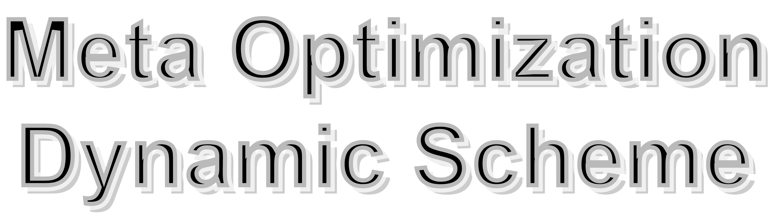
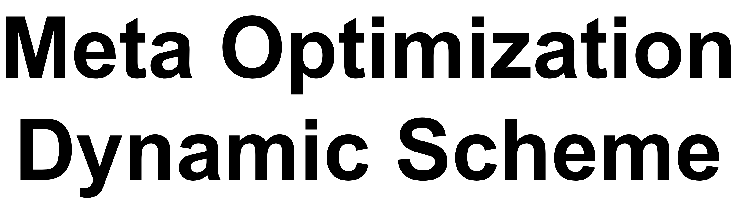
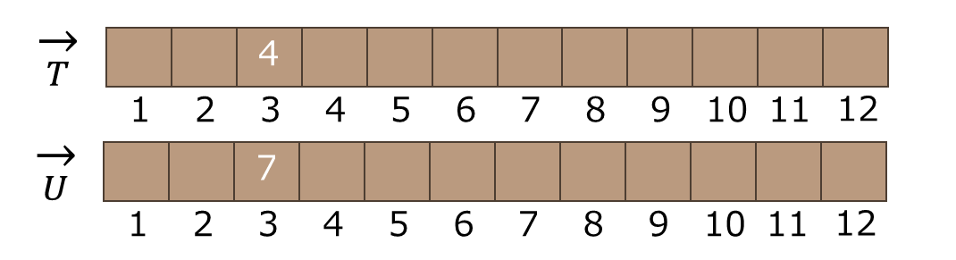
Control the conditioning based on the compatibility of the current model with the input bubble-diagram.
Use two 10-d vectors {Ti} and {Ui}, where i represents room types and two door types.
Example: Each element’s value ranges between [1,10] After the 4th
(respectively 7th) iteration, the previously generated mask is specified as the input condition if the current room/door is compatible (respect.
incompatible) for the 3rd room type.

Slide 21


There are three main quantitative evaluation metrics:
Realism: measured by a user study with professional amateur architects.
Diversity: measured by Freschet Inception Distance (FID) scores.
Compatibility: measured by the graph edit distance (GED).

Slide 22
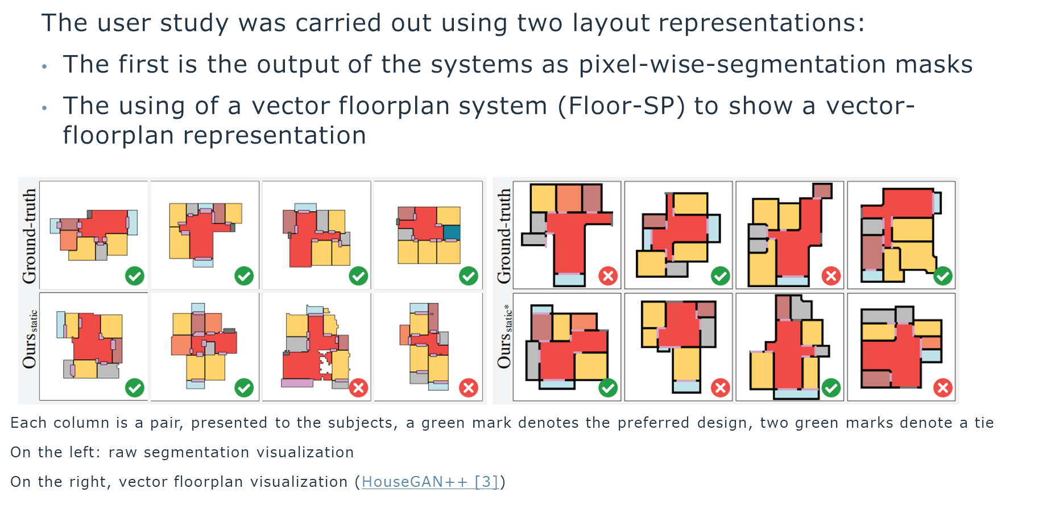
The user study was carried out using two layout representations:
The first is the output of the system, as pixel-wise-segmentation masks.
The using of a vector floor plan system (Floor-SP) to show a vector-floor plan representation.
Denotes the preferred design
[1] House-GAN++

Slide 23
Freschet Inception Distance:
Metric (FID) used to assess the quality of images generated. It is done so by calculating the distance between the feature vectors of fake images, and of real images, The lower the FIED scores, the better the quality of images generated are.

Slide 24
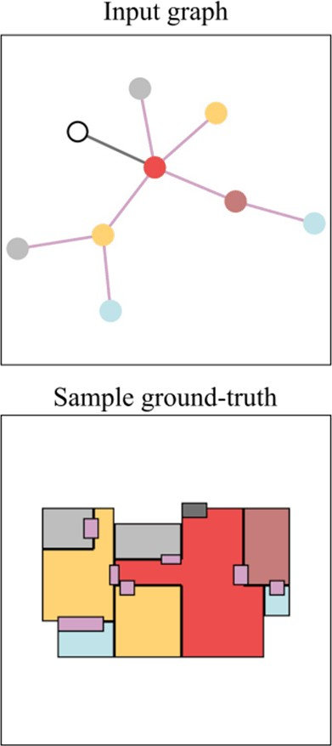
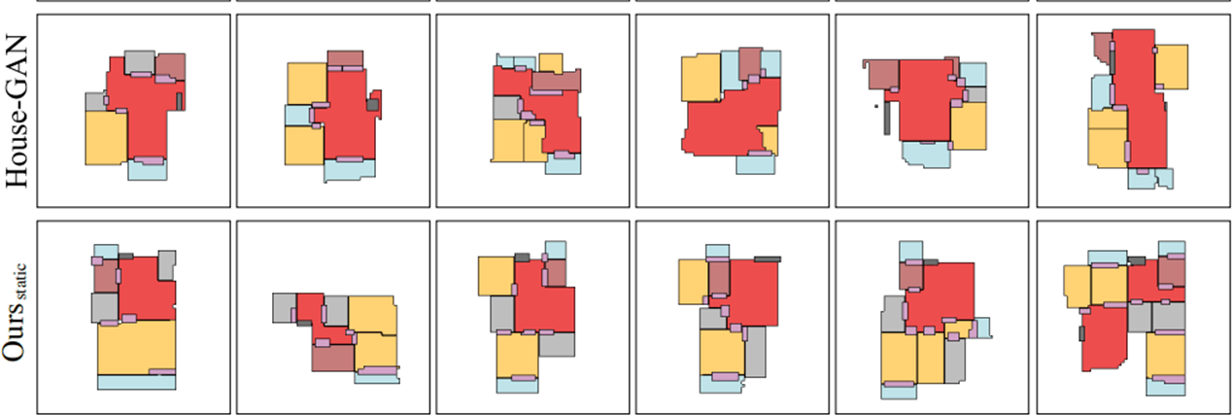
Showing six samples generated by each method from a given input bubble-diagram [1] HouseGAN++

Slide 25
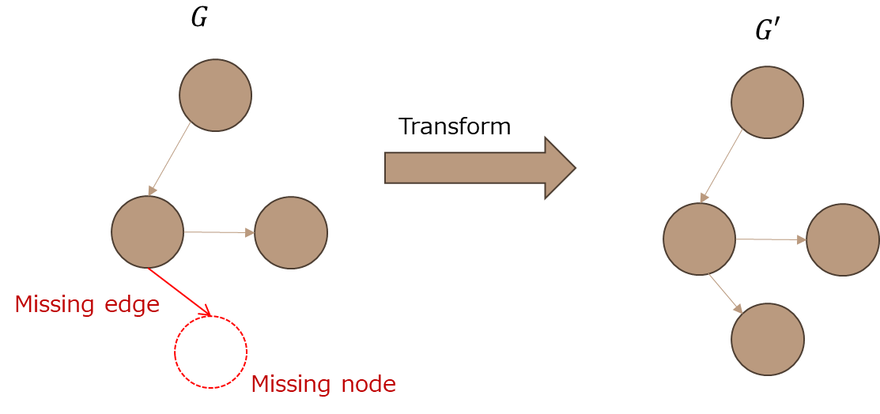
Measured by Graph Edit Distance (GED), addressed to the minimum number of operations (insertion, deletion, etc) needed to transform a graph into another.

Slide 26
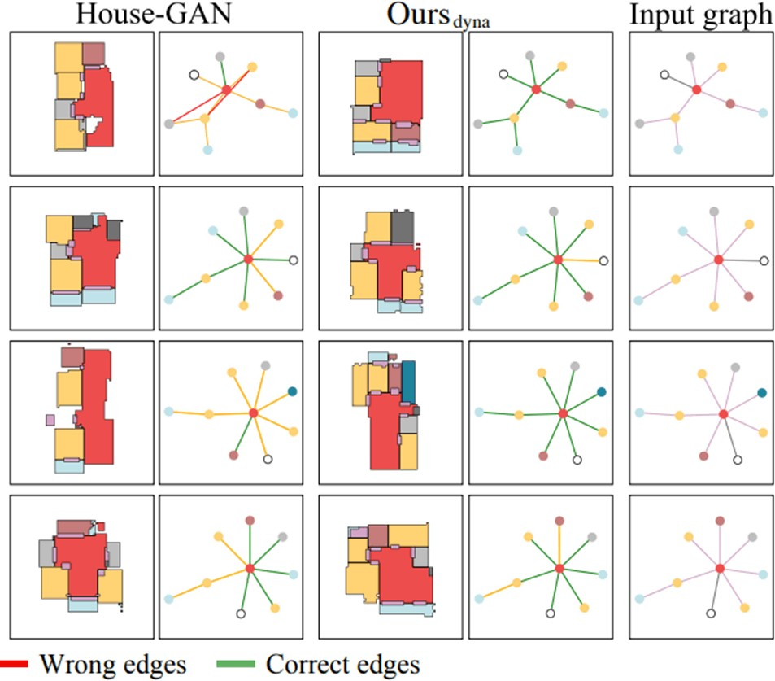
Missing

Slide 27


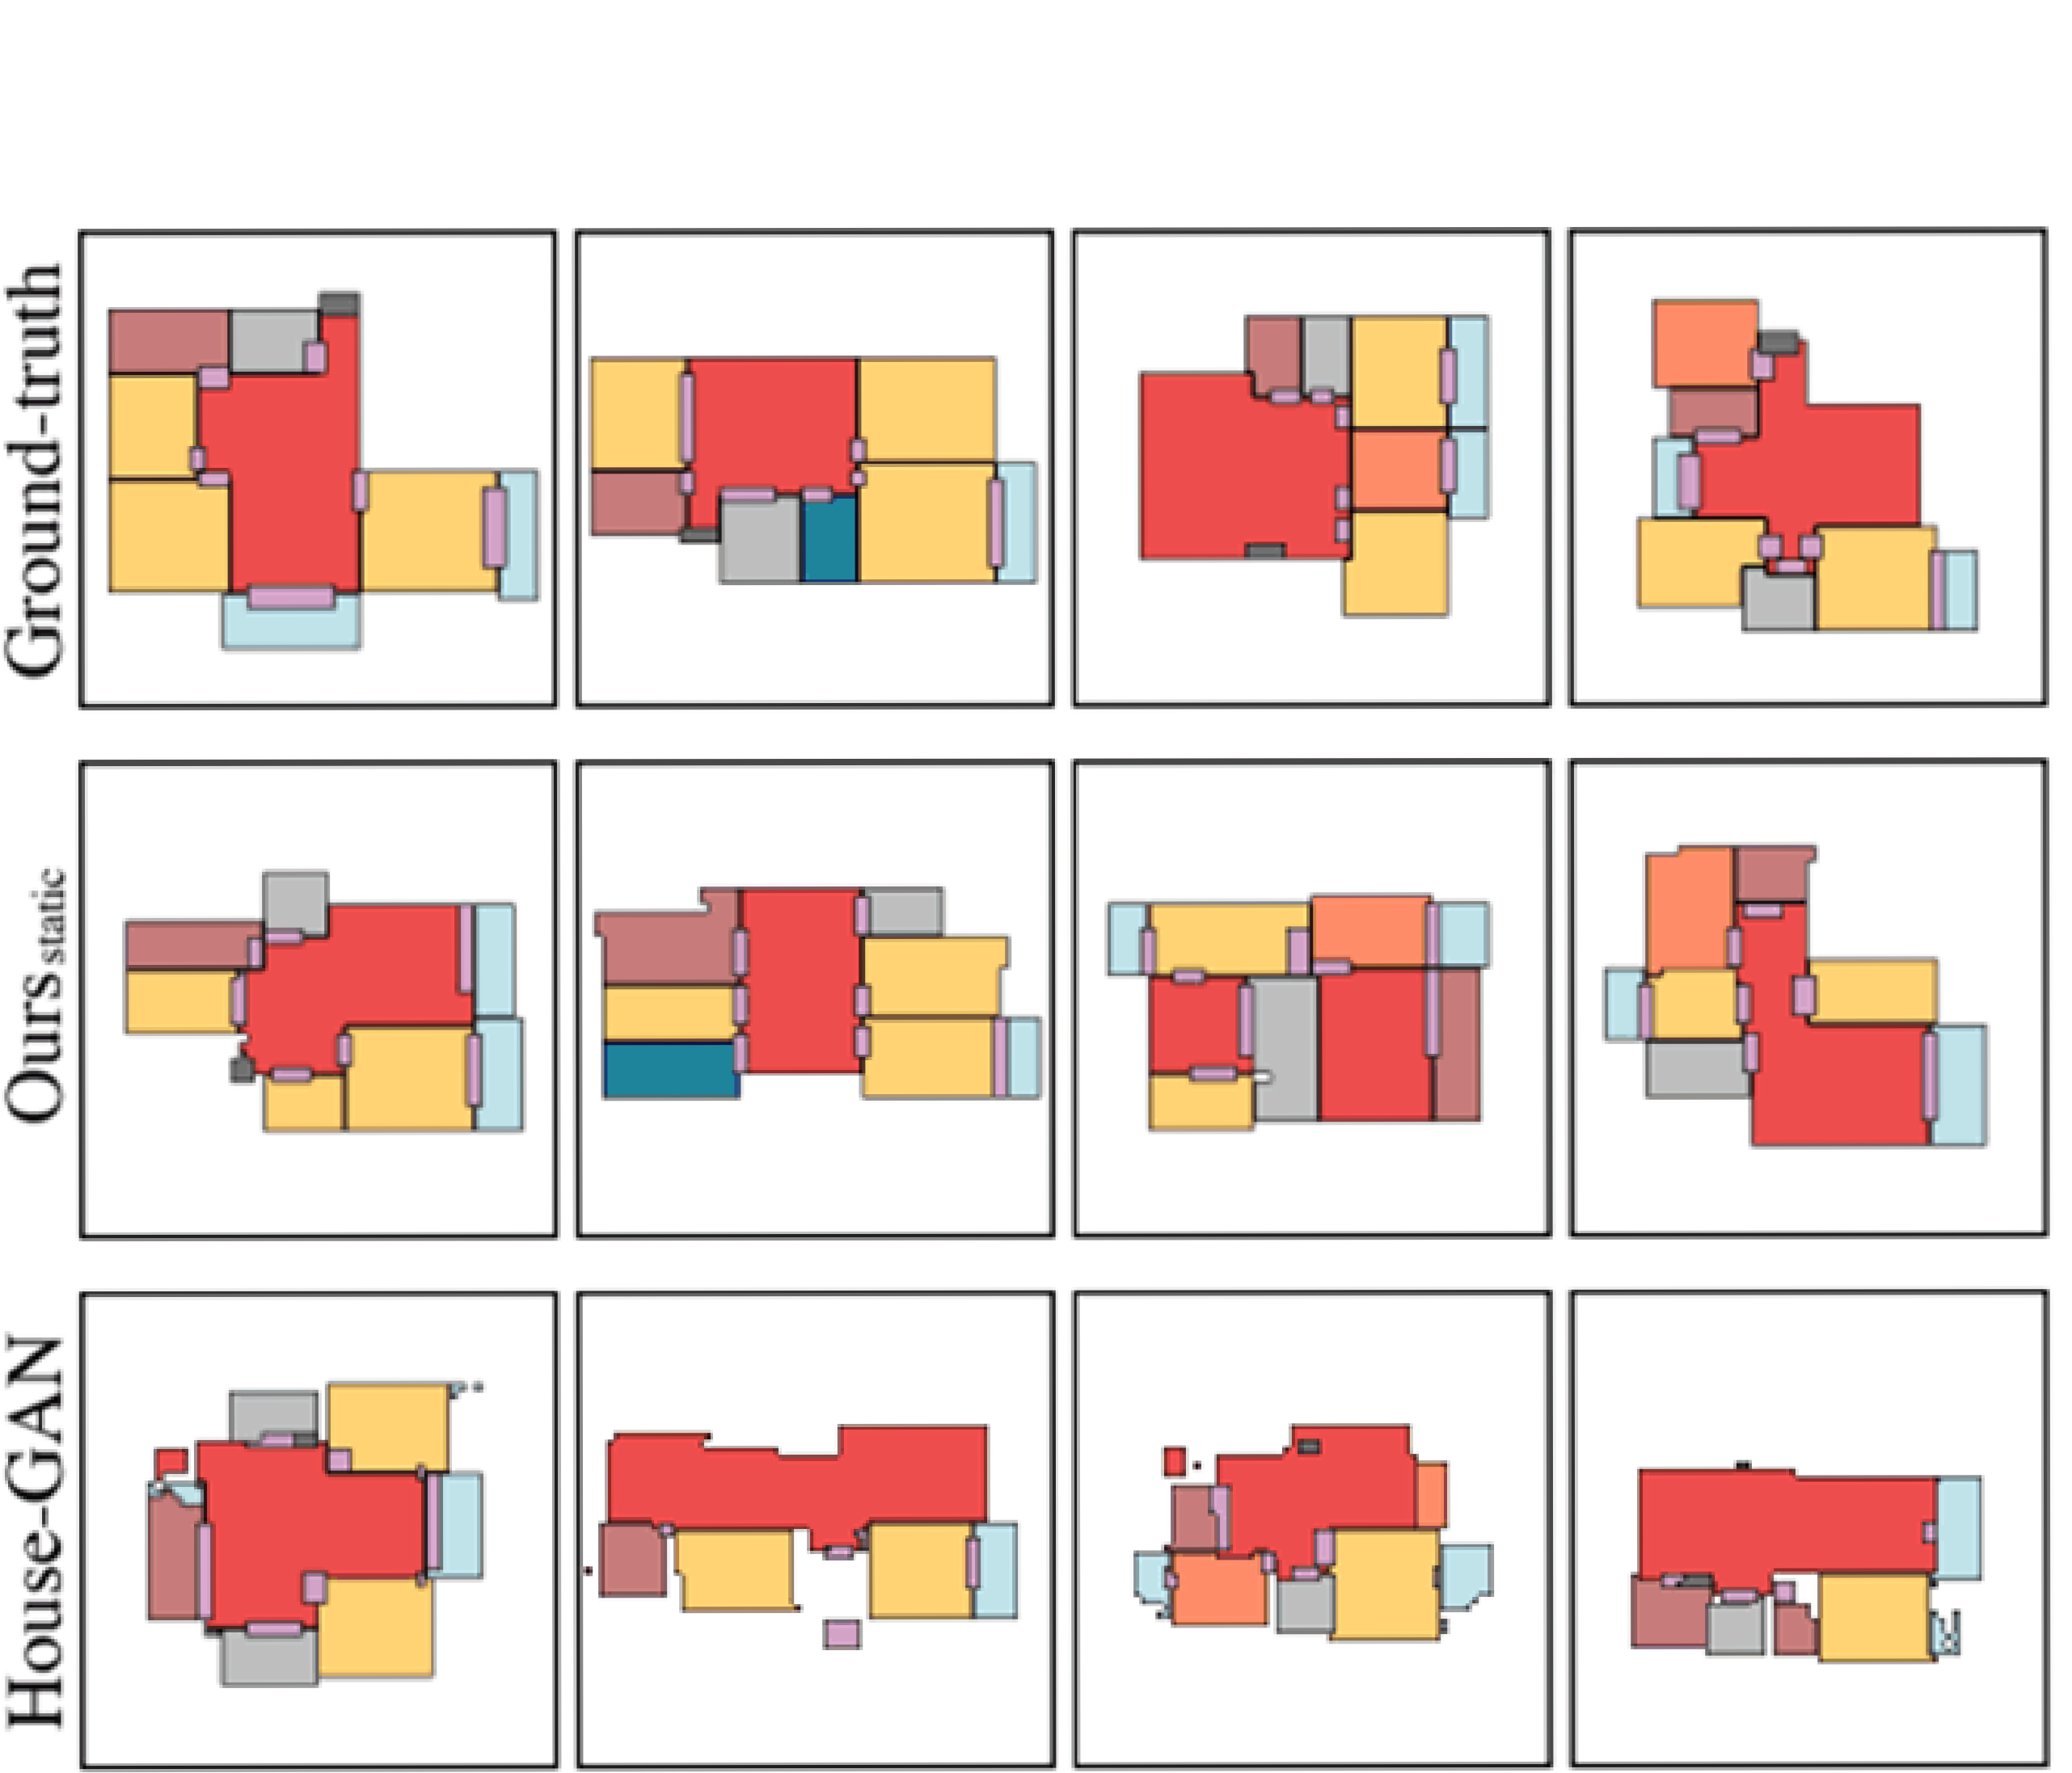
[1] House-GAN++

Slide 28


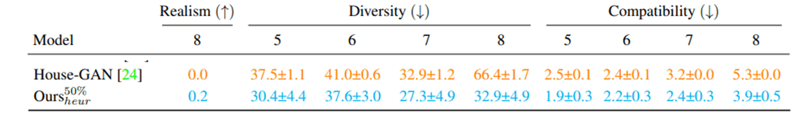
[1] House-GAN++

Slide 29


HouseGAN++ is a clear improvement over HouseGAN
We saw how the architecture is designed, and how it’s optimized.
Can often generate floorplans indistinguishable from those produced by architects, this sets a milestone in house layout generation.

Slide 30
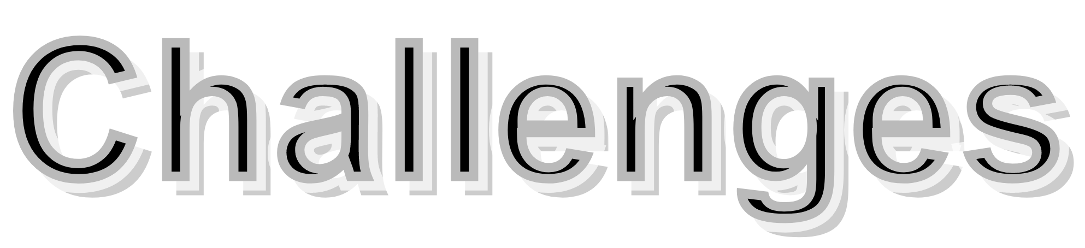

The output floor plans may not meet the regulations introduced in the country that the model is being used at.

Slide 31

When POC ends, there is option of incorporating with the Israeli
Architecture Institue to get Israeli regulations for constructing floor plans.
Otherwise, get a set of basic architectural rules.
- Validate one of the above.
Could add an option in the GUI for input regulations on rooms.
Consider training the model to accept rules from different countries.

Slide 32

Training a model requires a lot of computational power.
Finding the right environment to run the model may be challenging, several options are on the table like using Collab, or last resort Google or Amazon clouds provide with restricted amount of free use.

Slide 33


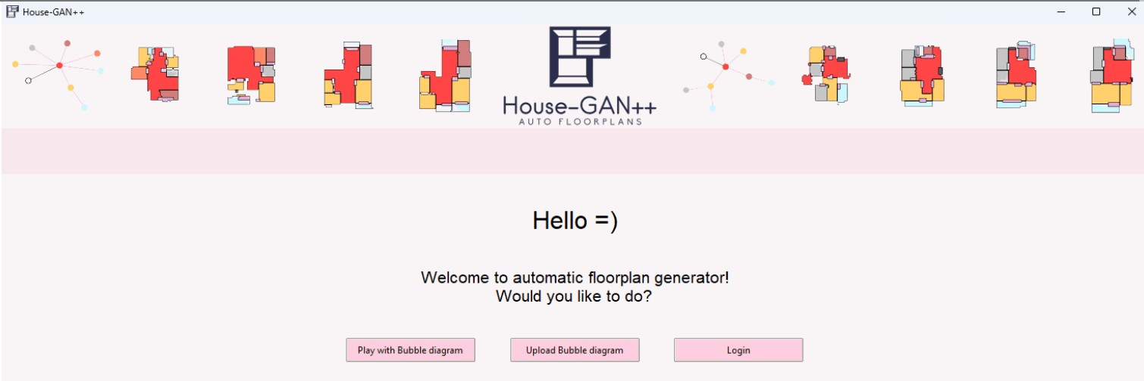

Slide 34
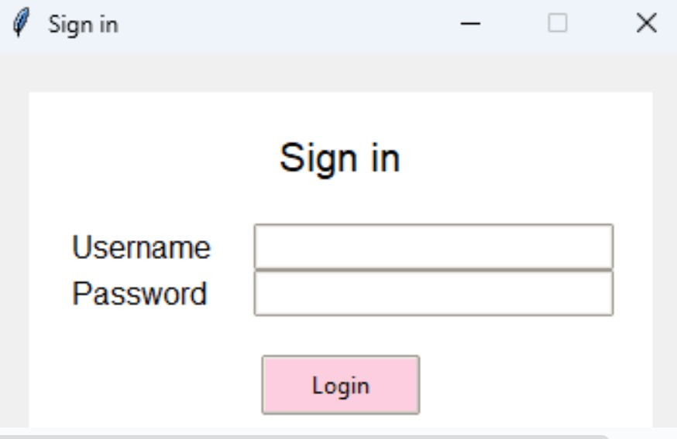

Slide 35
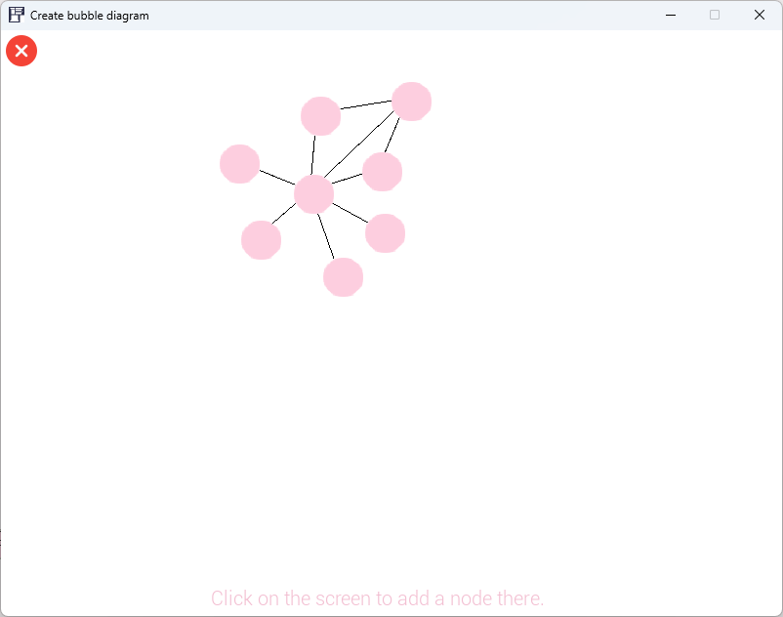

Slide 36
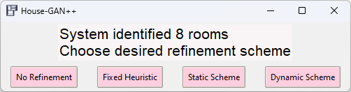

Slide 37


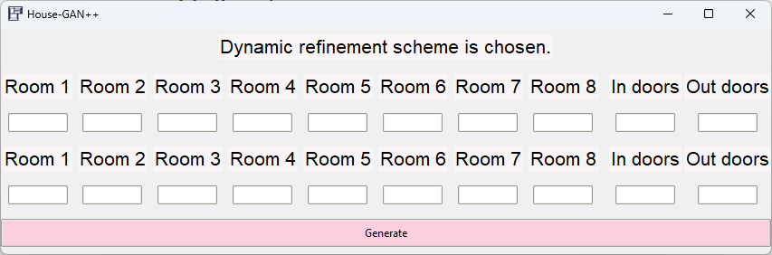

Slide 38
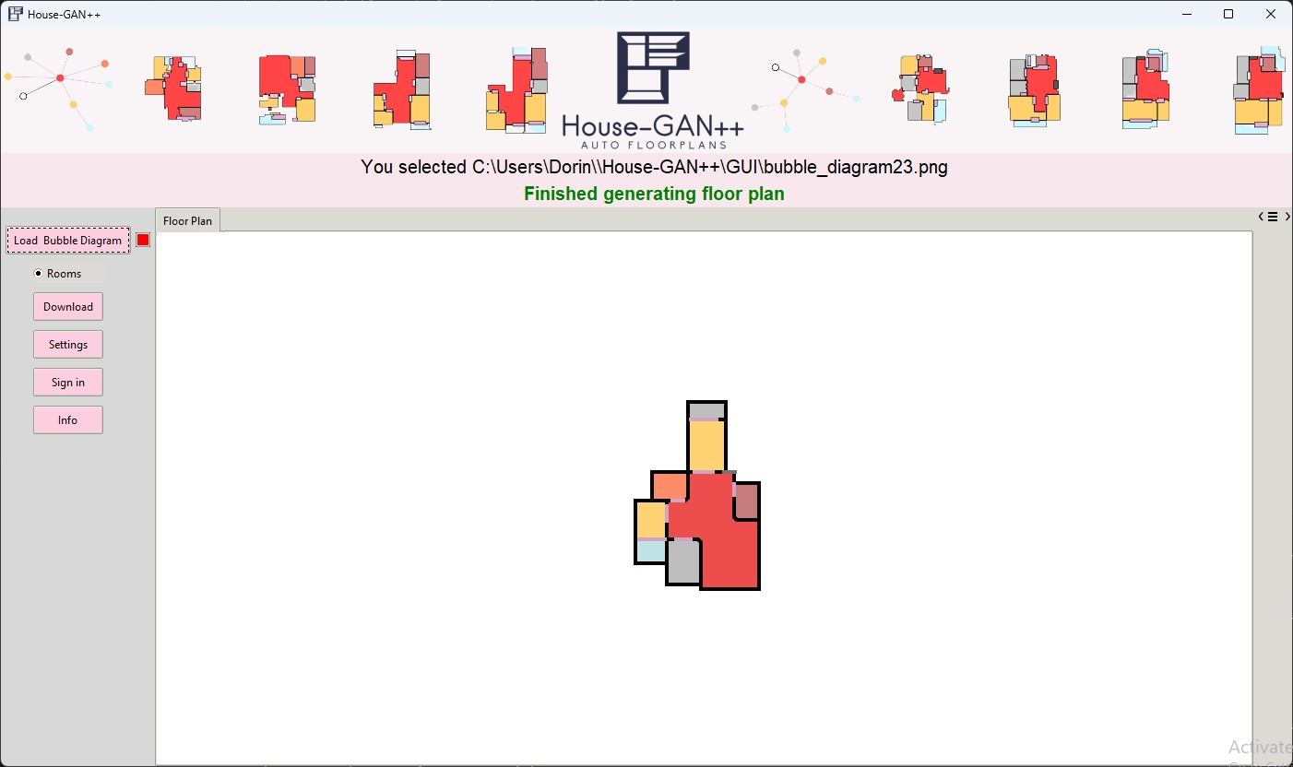

Slide 39


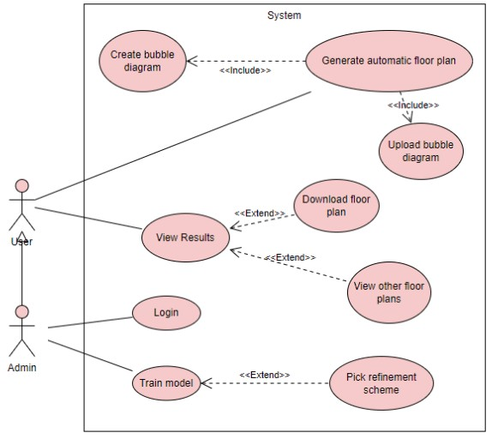

Slide 40


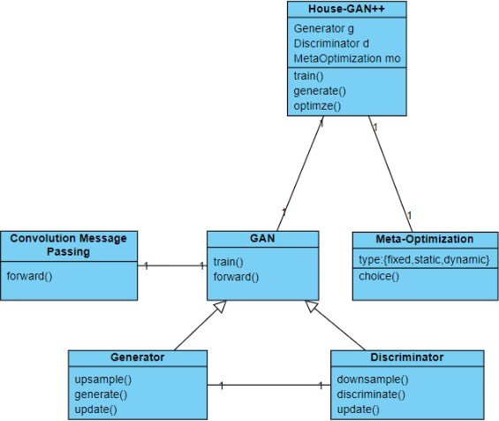

Slide 41


Nelson Nauata Simon Sepidehsadat Hosseini Simon Fraser Kai-Hung Chang Hang Chu Chin-Yi Cheng Yasutaka Furukawa Simon Fraser House-GAN++
Nelson Nauata Kai-Hung Chang Chin-Yi Cheng Greg Mori Yasutaka Furukawa Simon Fraser House-GAN
Conv-MPN: Convolutional Message Passing Neural Network for Structured Outdoor Architecture Reconstruction Fuyang Zhang Nelson Nauata Yasutaka Furukawa Simon Fraser
Convolutional Neural Networks on Graphs with Fast Localized Spectral Filtering Michaël Defferrard Xavier Bresson Pierre Vandergheynst
Generative Adversarial Nets Ian J. Goodfellow, Jean Pouget-Abadie Mehdi Mirza Bing Xu David Warde-Farley Sherjil Ozair Aaron Courville Yoshua Bengio

Slide 42



